Slide 1
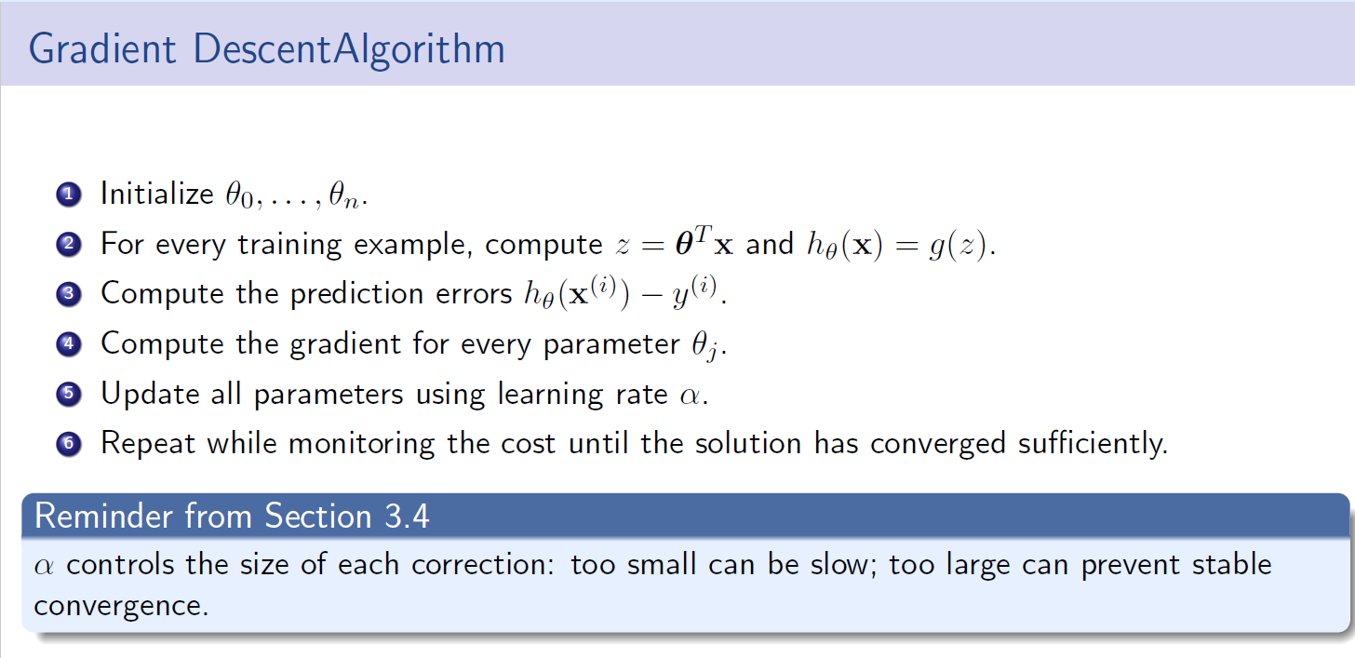
Gradient Descent

Slide 2
